Slide 1





Number Guessing Game in C
Presented By:
Miraya Ballav (PRN: 1262251072)
Namya Baranwal (PRN: 1262252097)
Saksham Jain (PRN: 1262250842)
Vedant Puri. (PRN: 1262252793)
Vedant Belsare. (PRN: 1262252826)
Course: Btech Cse-Csf
Division: 13
Subject: Foundations of Programming

Slide 2

Introduction: What's This Game About?
This project is a simple number guessing game made in C. It's pretty straightforward but covers some basic programming stuff.
The computer picks a secret number between 1 and 100.
Players try to guess this number.
The game gives hints if the guess is too high or too low.
You only get a limited number of tries (10, to be exact!).

Slide 3





Our Objectives: What We Learn
Making this game helps us get better at a few key programming concepts. It's like a mini-project to practice what we've learned.
Random Numbers
Loops
How to make the computer pick a random secret number.
Using loops (like do-while) to keep the game going.
Conditions
Input/Output
Using if-else to check guesses and give hints.
Taking guesses from the player and showing messages.

Slide 4



Libraries Used: Our Programming Toolkit
To make this game work, we need to include a few standard libraries. Think of these as pre-built tools that help us with common tasks.
<stdio.h>: This is for standard input/output. It helps us:
  printf(): display text on the screen (like prompts and hints).
  scanf(): read input from the player (their guess).
<stdlib.h>: This library provides general utilities. We use it for:
  rand(): generate random numbers.
  srand(): "seed" the random number generator so it's not the same every time.
  abs(): get the absolute value (useful for hint system logic).
<time.h>: For time-related functions. We use it to:
  time(NULL): provide a unique seed for srand(), usually based on the current time.

Slide 5

Random Number Generation: Making It Unpredictable
The game needs a secret number that's different each time you play. This is how we do it.
1. Seeding the Generator
2. Generating the Number
srand(time(NULL));
int num = (rand() % 100) + 1;
srand() initializes the random number generator.
time(NULL) gives us the current time in seconds since 1970. This makes sure our random numbers aren't the same every time we run the program.
You only call srand() once, at the beginning of main().
rand() gives a big random integer.
% 100 (modulo 100) makes the number fall between 0 and 99.
+ 1 shifts the range to be between 1 and 100, which is what our game needs.

Slide 6

Game Loop & Attempts: The Core Gameplay
The game keeps going until you guess correctly or run out of tries. We use a do-while loop for this.
do-while Loop:
  The code inside the do block runs at least once, which is good because the player needs to make at least one guess.
  The loop continues while (guess != num), meaning it keeps going as long as the guess isn't right.
Attempt Limit (10 tries):
  We have a variable, attempts, that counts how many guesses the player has made.
  Before each guess, we check if (attempts > 9). If it is, the player loses, and we use break; to exit the loop.
  Each time the player makes a guess (and it's not correct), we increment attempts++.

Slide 7
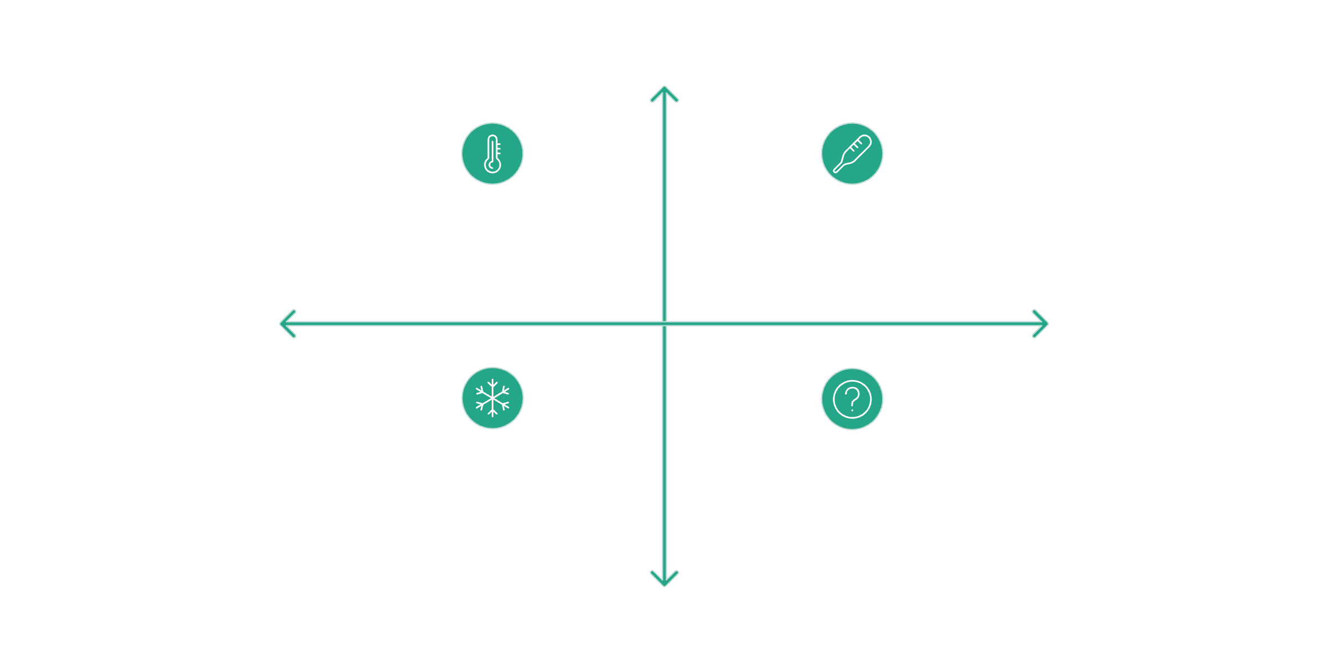





Hint System: "Very Hot", "Warm", "Cold"
To help players, we give hints based on how close their guess is to the secret number.
Very Close
Very Hot & Precise (diff <5)
Warm - Close (diff 5–15)
No Input
More Effort
Cold - Far (diff >15)
No Guess Yet / Idle
Far Away
We calculate the difference using diff = abs(num - guess); (remember abs() from <stdlib.h>?).
Very Hot: if (diff < 5)
  Your guess is super close to the actual number.
Warm: else if (diff < 15 && diff > 5)
  You're getting closer, but not super close.
Cold: else
  Your guess is pretty far away from the target.

Slide 8
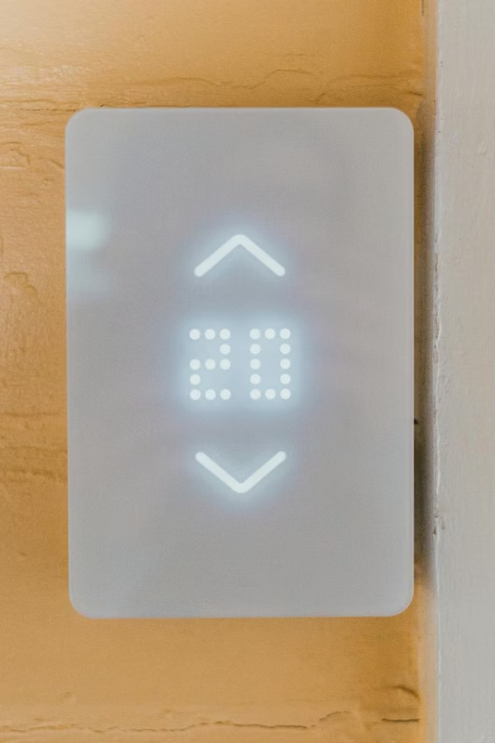


Direction Guidance: Higher or Lower?
Besides closeness, we also tell the player if their guess was too high or too low. This narrows down the possibilities.
Guess Lower!
If guess > num: The player's number is bigger than the secret number. They need to aim for a smaller number next time.
Guess Higher!
If guess < num: The player's number is smaller than the secret number. They need to aim for a larger number next time.
If neither of these conditions is true, it means guess == num, and the player has won!

Slide 9





Concepts Used: The Building Blocks
This simple game uses several fundamental C programming concepts.
Loops (do-while)
Conditions (if-else if-else)
For repeating actions until a condition is met.
For making decisions and providing different feedback.
Functions (main, printf, scanf, rand, srand, time, abs)
User Input/Output
Interacting with the user (getting guesses, giving results).
Pre-written code blocks to perform specific tasks.

Slide 10
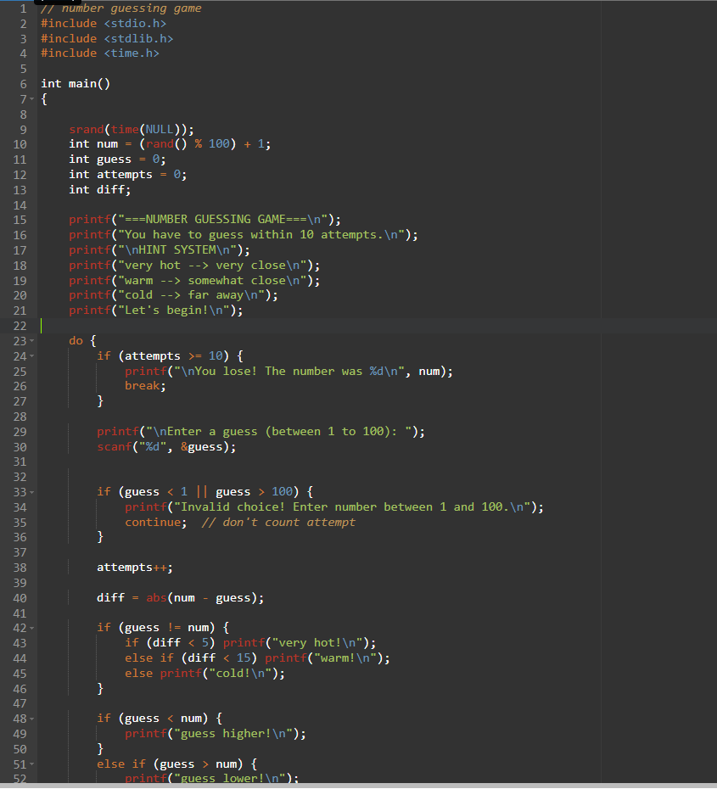
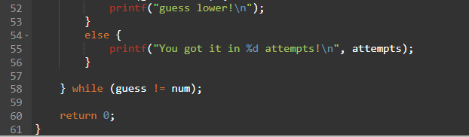
CODE

Slide 12
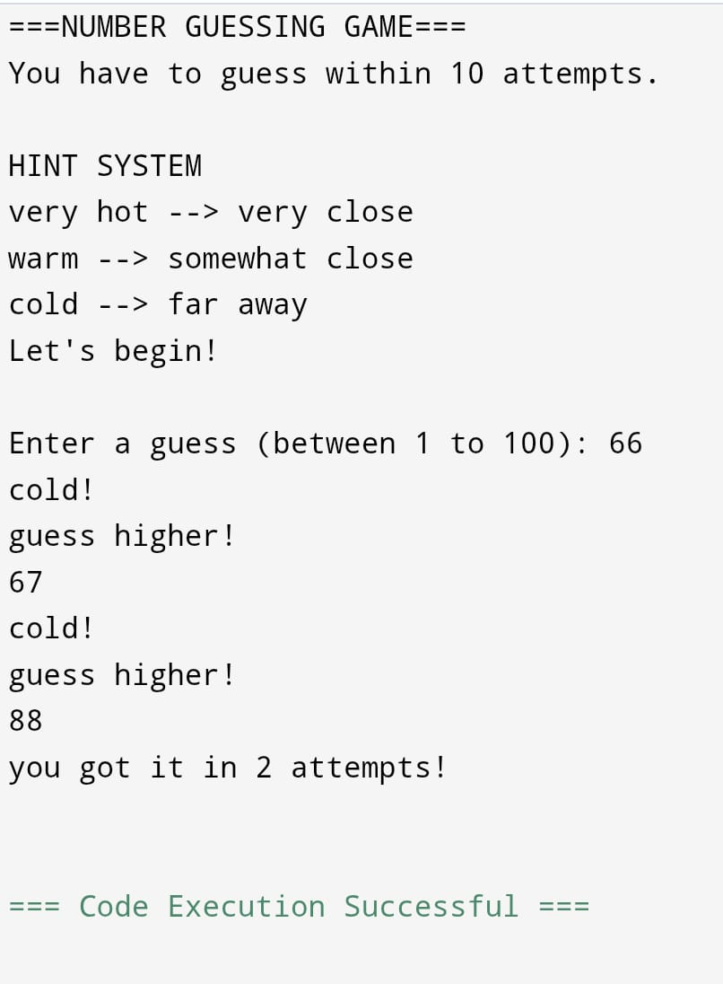
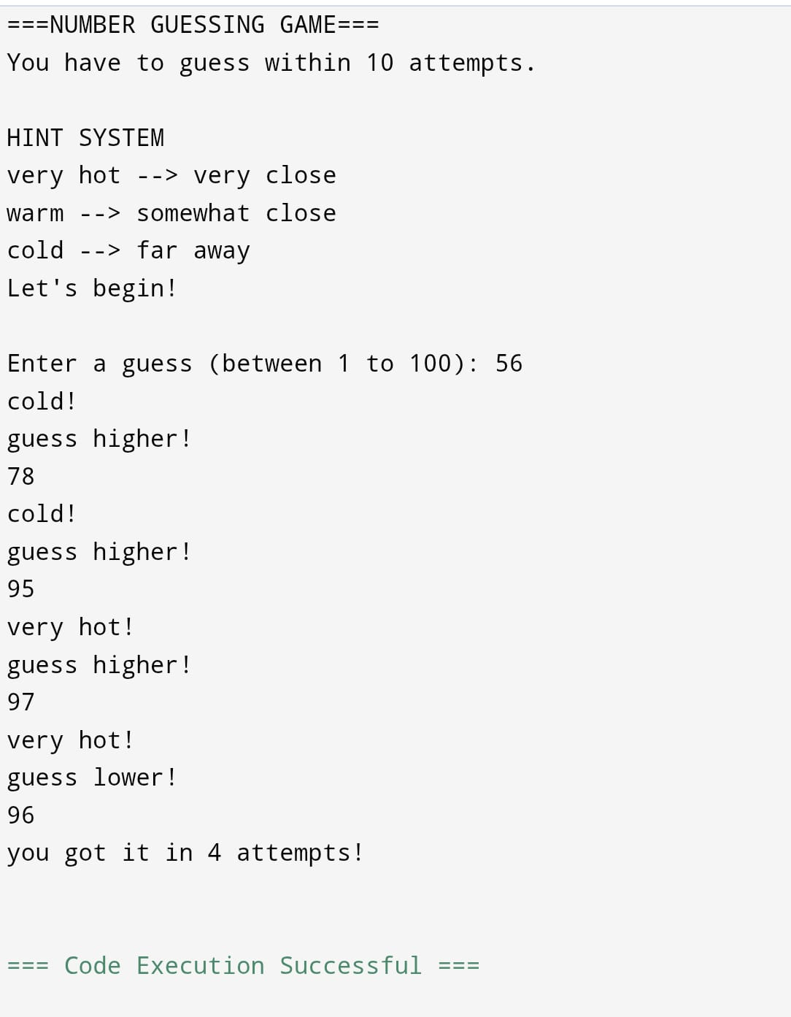
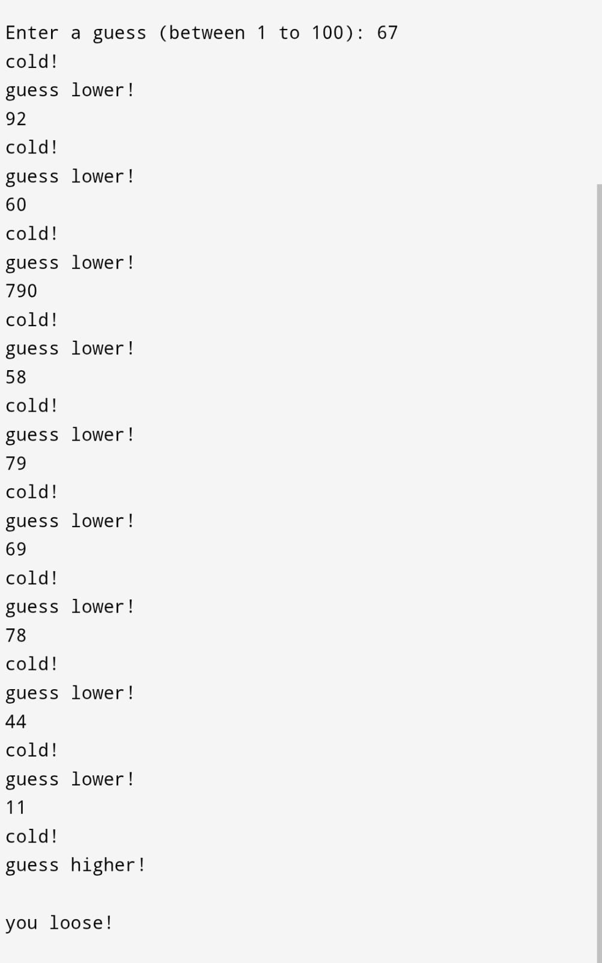
OUTPUT OF THE CODE

Slide 13
ALGORITHM FOR THE CODE
Start
Generate random number (1–100)
Set attempts = 0
While attempts < 10
a. Input guess
b. attempts++
c. If guess == number → display win → stop
d. Find difference
e. Display hint (hot/warm/cold)
f. Display higher/lower
Display lose message
Stop

Slide 14

Conclusion & Future Improvements
This number guessing game helps us understand basic C programming. It's a good starting point!
Summary: We covered random number generation, game loops, hints, and input/output.
It’s a simple project that pulls together different things we've learned.
Possible Future Enhancements:
Difficulty Levels: Let the player choose the range of numbers (e.g., 1-50, 1-1000).
Player Names: Ask for the player's name and include it in messages.
High Scores: Save the best scores (fewest attempts) to a file.
More Detailed Hints: Maybe "getting warmer" or "getting colder" after each guess.

